Slide 1
CS210
Algorithms and Data Structures
Linked Lists
Week 9
Semester 1 2025
Dr. Pierpaolo Dondio

Slide 2
Week 9
Linked Lists Definition
Advantages vs. Arrays
Basic Operation
Java Implementation(s)

Slide 3
The trouble with Arrays
The main problem with arrays is that in order to move an item from one slot to another it has to be copied, pasted and deleted
This is very time consuming – can we come up with an alternative that avoids this process?
Copy and paste
1
3
7
8
9
5

Slide 4
Array LImitations
Arrays waste space because they are not always full!
When they get full it is not easy to extend them
To insert a new element in a particular slot we must copy the exisiting array to a new larger array

Slide 5
Linked list
Node
data
link
What is a Linked List?
An abstract data structure
Consists of a sequence of links
Individual links can also be called nodes
Each node stores:
Data
Link to the next node
Why are linked lists better than arrays?
data
Node
link
data
Node
link
data
Node
link
NULL

Slide 6


Linked Lists
Linked lists avoid all the problems of arrays because they can adapt their ordering by changing the items they point to
No memory is wasted and extra links can easily be added

Slide 7

Structure
A Linked List stores the first or head node for all the subsequent Node objects
Linked List object is instantiated to point to the start of the list and multiple Nodes objects are created for each link in the list
All nodes contain references to the next node in the list

Slide 8
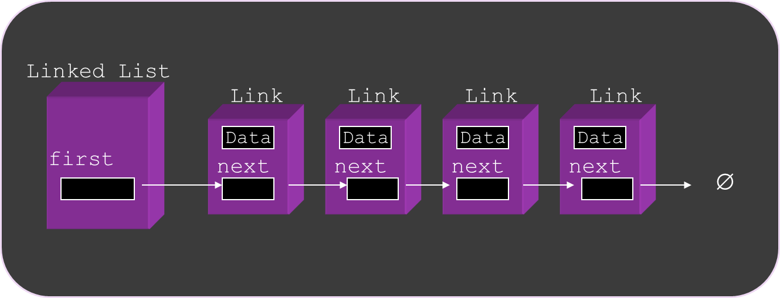
Structure
The Linked List class stores a reference to the first link
The Node class (called Link in the picture below) stores a bit of data and a reference to the next link

Slide 9
Java Implementation
class LinkedList {
private Node first;
public LinkedList( ){
head=null;
}
public boolean isEmpty( ){
return (head==null);
}
……
}
LinkedList cointains the first pointer to the list (called the head of the list). It only contains a reference to the first link
This is originally set to null
Now we need to specify how a node is defined

Slide 10
Java Implementation / the node
public class Node{
public int data;
public Node next;
// constructor
public Node(int datain)
{
data = datain; // next is set to null
}
}
Note that although the Node object contains another Node (next), this is only a reference to the next Node
This is the same for any object, the label (e.g. next) is only a reference and does not represent the actual object itself

Slide 11
Linked List Basic Operations
Insert at the Head
Delete at the Head
Traverse the List
Insert at a specific position
Delete at a specific position

Slide 12
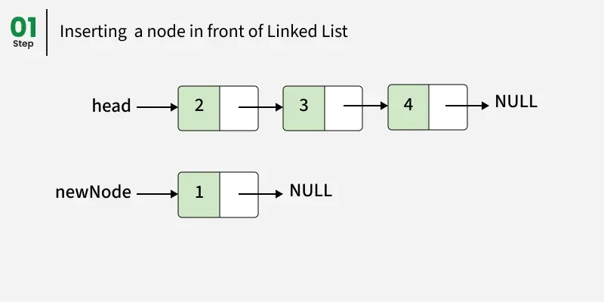
Inserting at the Head

Slide 13
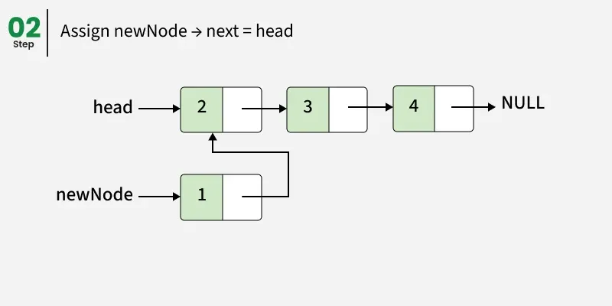
Inserting at the Head

Slide 14
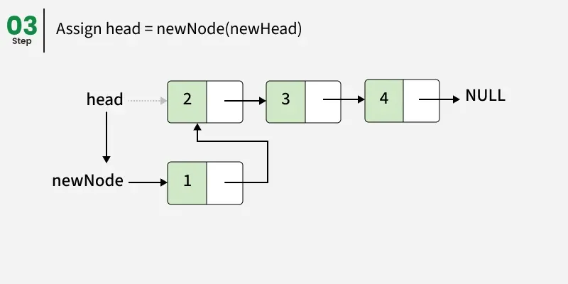
Inserting at the Head

Slide 15
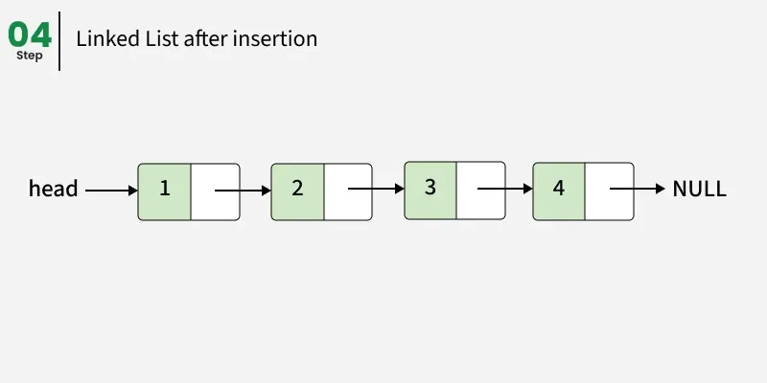
Inserting at the Head

Slide 16
Insert at Head
public void insertHead (int number) {
Node newNode = new Node(number);
newNode.next = head;
head = newNode;
}
This insertHead( ) method in LinkedList does the following
takes in a number
creates a new link with that piece of data
sets that link to point to the old first link
sets the first link to point to the new link

Slide 17
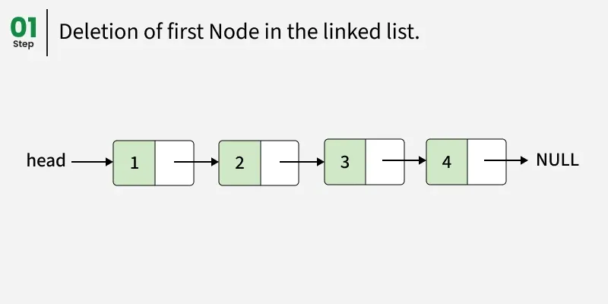
Deleting at the Head

Slide 18
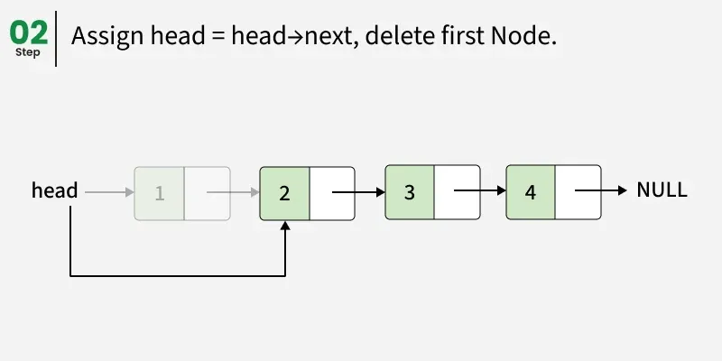
Deleting at the Head

Slide 19
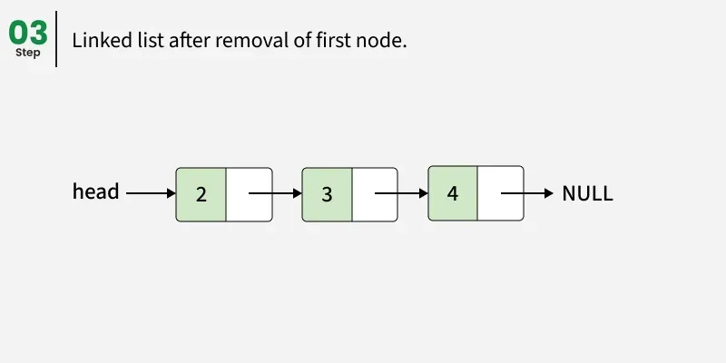
Deleting at the Head

Slide 20
Delete at Head
This method in LinkedList does the following
Backs up the first link
Gets the link after the first link
Puts the old first link equal to that
Returns the link that has been ‘bypassed’
public void deleteHead () {
head = first.next;
}

Slide 21
Traversing a linked list
public void display {
Node current = head;
while(current!=null){
current.displayLink();
current=current.next;
}
}
With arrays, each item occupies a particular slot, and we can index any slot we like
With a linked list, you have to start at the beginning of the chain and work your way along in order to find an item
Binary search not possible – big disadvantage of linked lists
Why is binary search not possible?

Slide 22
Finding a Node
What if we want to find one node with a specific value of the key?
The algorithm works like this:
Take in the value to be found
Start at the beginning of the list
Keep moving down the nodes until we find the correct one

Slide 23
SEARCHING IN a linked list
public void search(int key) {
Node cur = head;
// iterate over all the nodes
while (curr != null) {
// if the current node = key,
// return true
if (curr.data == key)
return true;
// Move to the next node
curr = curr.next;
}
// otherwise return false
return false;
}
With arrays, each item occupies a particular slot, and we can index any slot we like
With a linked list, you have to start at the beginning of the chain and work your way along in order to find an item
Binary search not possible – big disadvantage of linked lists
Why is binary search not possible?

Slide 24
Inserting at a specific position
We can insert at a specific position
This is useful if we want to keep the list sorted
Idea:
create a new node
Find the spot where it should be placed: walk through the list until you reach the node j just before that position.
Link the new node’s next to the node following j
adjust node j’s next to point to the new node.

Slide 25
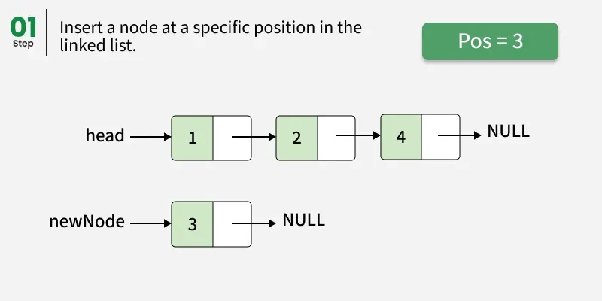
Inserting at a specific position

Slide 26
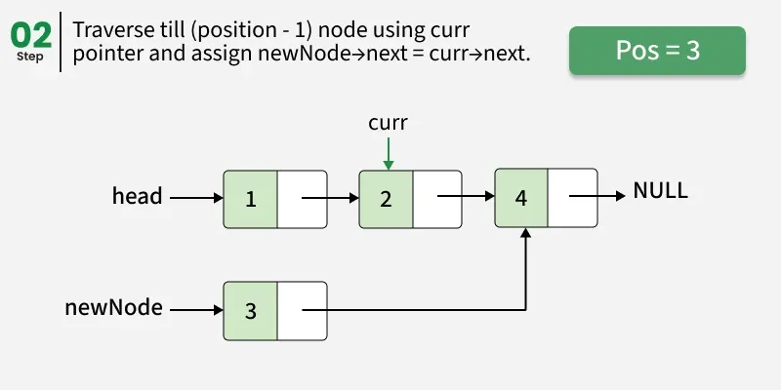
Inserting at a specific position

Slide 27
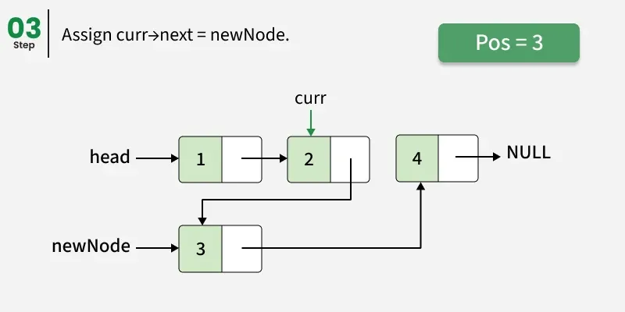
Inserting at a specific position

Slide 28
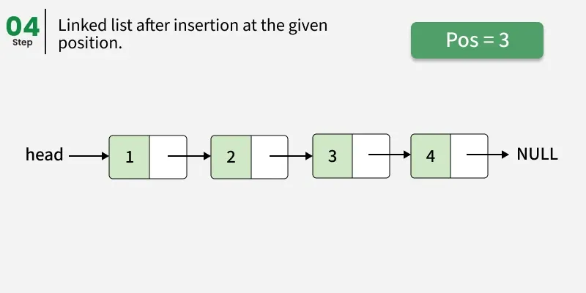
Inserting at a specific position

Slide 29
INSETING at a specific location
static Node insertPos(Node head, int pos, int val) {
if (pos < 1) return head;
// head will change if pos=1
if (pos == 1) {
Node newNode = new Node(val);
newNode.next = head;
return newNode;
}
Node curr = head;
// Traverse to the node that will be present just before the new node
for (int i = 1; i < pos - 1 && curr != null; i++) {
curr = curr.next;
}
// If position is greater than the number of nodes
if (curr == null) return head;
Node newNode = new Node(val);
// update the next pointers
newNode.next = curr.next;
curr.next = newNode;
return head;
}

Slide 30
INSETING at a specific location (sorted LIST)
static Node insertSorted(int val) {
Node newNode = new Node(val);
Node prev = null; //I need this to be able to insert before a node with higher value
Node curr = head;
// Traverse to the node until we find the right location
while (curr != null && curr.data < val) {
prev = curr;
curr = curr.next; }
if (prev == null) {
// Insert at the head, previous was never updated
newNode.next = head;
head = newNode;
} else {
// Insert between prev and curr
newNode.next = curr;
prev.next = newNode;
} }

Slide 31
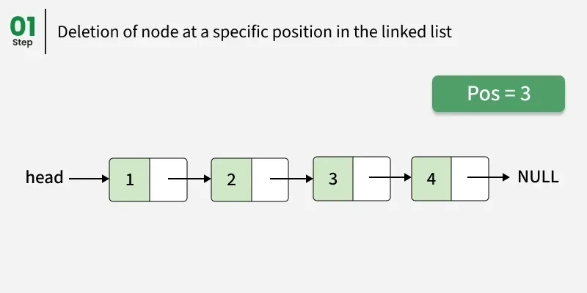
Deleting at a specific position

Slide 32
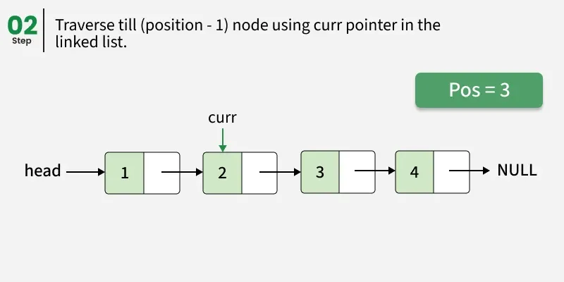
Deleting at a specific position

Slide 33
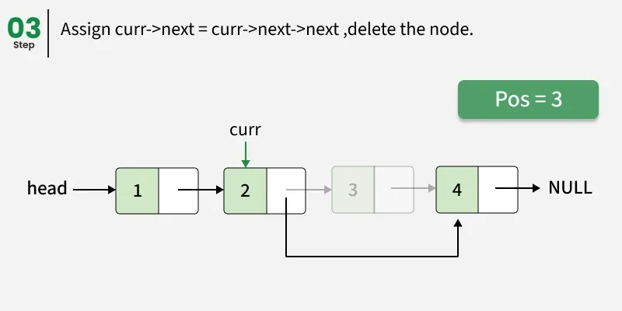
Deleting at a specific position

Slide 34
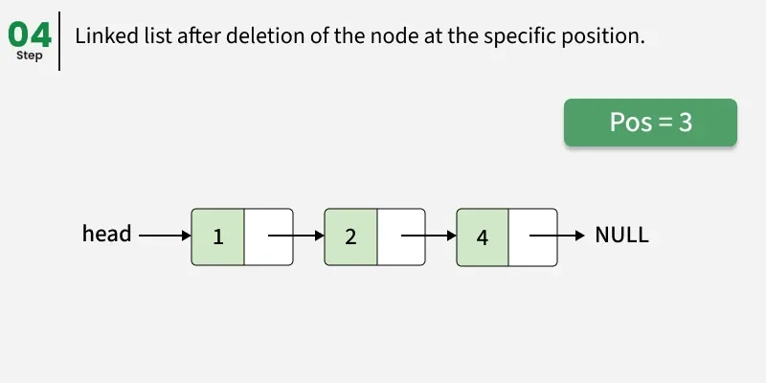
Deleting at a specific position

Slide 35
DELETE from A sorted LIST
static Node deleteNode(int key) {
if (first == null) { //Empty list
return null;}
Node curr = first;
Node prev = null;
// Traverse until we find the node to delete or pass its position
while (curr != null && curr.data < key) {
prev = curr;
curr = curr.next;}
// Key not found
if (curr == null || curr.data != key) {
System.out.println("Key " + key + " not found.");
return first;
}
if (prev == null) {
head = head.next; // Deleting head, prev was never moved
} else {
prev.next = curr.next; // Deleting middle or last node
}
return first;}

Slide 36
Double-Ended Linked Lists
A double-ended list is similar to an ordinary linked list with one additional feature
It has a reference to the last link as well as the first
This allows a new link to be inserted or deleted at the end as well as the beginning
Can be used to implement a queue (items arrive one end and leave at the other)
Linked List
last
Link
Link
Link
Link
first
Data
Data
Data
Data
next
next
next
next
∅

Slide 37
Linked-List Efficiency
Insertion and deletion at the beginning of a linkedlist are very fast → O(1)
Finding, deleting or inserting in a particular location requires traveling through an average of half the links, but the worse case scenario is all links so the big O notation is… → O(n)
However, nothing needs to be copied, so it is a faster O(n) than array insert – only references are updated
Major advantage is that no memory is wasted
Note: Vectors in Java are expandable arrays but these usually expand more than they need to

Slide 38
Stack with a Singly Linked List
We can implement a stack with a singly linked list
The top element is stored at the first node of the list
The space used is O(n) and each operation of the Stack ADT takes O(1) time
links
top
∅
elements

Slide 39
Queue with a Single Linked List
We can implement a queue with a double ended linked list
The front element is stored at the first node
The rear element is stored at the last node
The space used is O(n) and each operation of the Queue ADT takes O(1) time
rear
links
front
∅
elements

Slide 40
Using linked lists for array sorting
Take the items from your unsorted array
Put them into a sorted linked list one by one
You can then put them back in the array and it will be sorted
Actually turns out to be significantly more efficient than insertion sort because fewer copies are necessary!
Still O(n²) comparisons, however each item is only copied twice
Once from the array to the linked list
Once back from the linked list into the array
2n copies is much better than the usual O(n²) copies using Insertion Sort

Slide 41
Double-Ended Doubly Linked Lists
Linked List
last
Link
Link
Link
Link
first
Data
Data
Data
Data
next
next
next
next
∅
prev
prev
prev
prev
∅

Slide 42
Double-Ended Doubly Linked Lists
The specification for the node class now looks like this:
public class Node{
public int data;
public Node next;
public Node previous;
}
Now every time we insert or delete a node, we must deal with four links instead of two
Update the two attachments between the previous node and the new one
Update the two attachments between the next node and the new one
Now we can move backwards or forwards through the list

Slide 43
Java built in classes
java.util.LinkedList;
Operation | Method | Description
Add at end | add(E e) | Appends element
Add at beginning | addFirst(E e) | Inserts element at front
Add at index | add(int index, E e) | Inserts at given position
Remove by value | remove(Object o) | Removes first occurrence
Remove by index | remove(int index) | Removes element at index
Remove first/last | removeFirst(), removeLast() | Removes ends
Access first/last | getFirst(), getLast() | Retrieves ends
Peek/poll | peek(), poll() | Retrieves/removes head (= queue)
Check element | contains(Object o) | Tests membership
Size | size() | Returns element count
Clear | clear() | Removes all elements
Navigate the list | Listiterator() | Navigate over the list backward and forward

Slide 44
Listiterator() method
LinkedList<String> list = new LinkedList<>();
list.add("A");
list.add("B");
list.add("C");
// Create a ListIterator
ListIterator<String> iterator = list.listIterator();
Method (E=element=node) | Description
boolean hasNext() | Returns true if there’s another element when moving forward.
E next() | Returns the next element.
boolean hasPrevious() | Returns true if there’s another element when moving backward.
E previous() | Returns the previous element.
int nextIndex() | Returns the index of the next element.
int previousIndex() | Returns the index of the previous element.
void add(E e) | Inserts a new element into the list.
void remove() | Removes the last element returned by next() or previous().
void set(E e) | Replaces the last element returned by next() or previous().

Slide 45
Listiterator() method
See the following demo files in JAVA:
LinkedListExample.java
SortedLinkedList.java
ListIteratorExample.java

